Slide 1
hardware support for OS
Instructor: William Zheng
Email: william.zheng@digipen.edu
PHONE EXT: 1745
Notes:
1

Slide 2
Goals for this lecture
HW and SW
CPU - I/O Communication
Interrupt handling
DMA
More details in chapter 13.1-13.2 of textbook
CPU modes
Backward-compatibility modes
Privilege modes

Slide 3
HW & SW
Difference?
Important to know the distinction
OS (SW)
But what OS can do
Limited by the hardware it’s running on

Slide 4
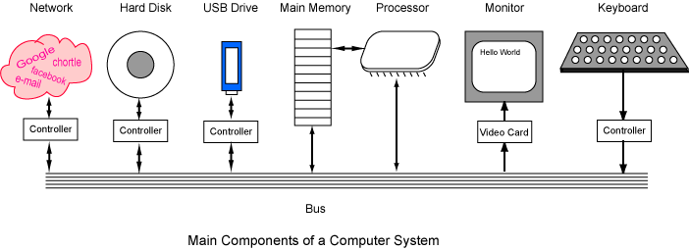
Computer System Components

Slide 5
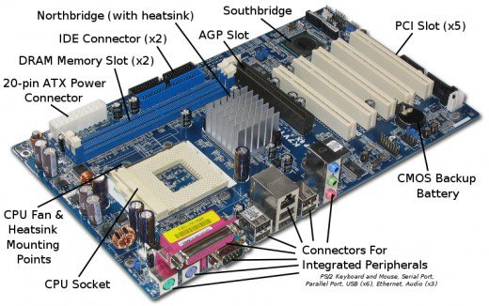
Motherboard

Slide 6
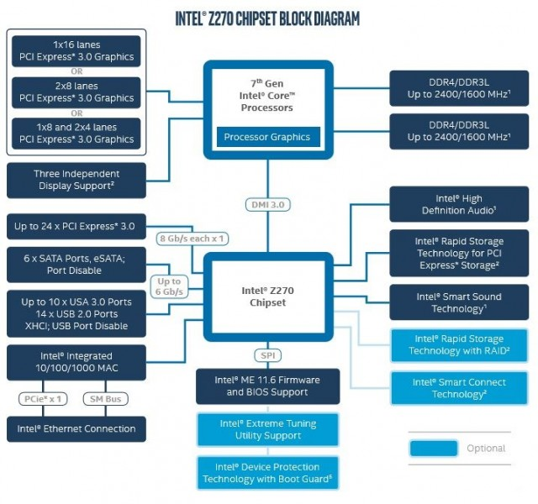
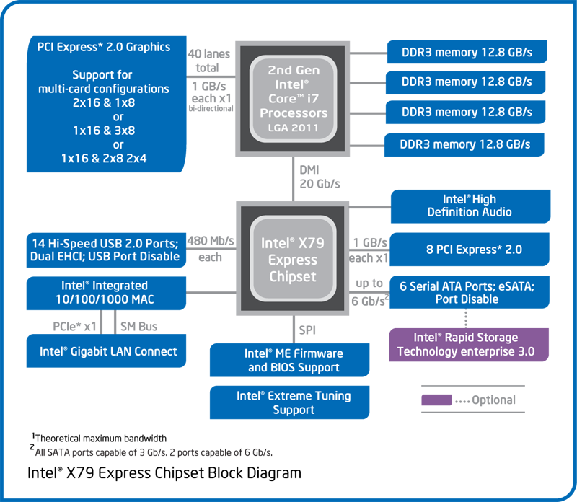
Chipset Block Diagram

Slide 7
Device Control Registers
Status register
Done bit
Error bit
Data register
Data to be printed
Control registers
Commands
Device Controller
Status
Data IN
Data OUT
Control

Slide 8
CPU – I/O Communication
From CPU to I/O
Special instructions
Memory-mapped I/O
Device data and command registers mapped to processor address space
Especially for large address spaces (graphics)
From I/O to CPU
Polling
Interrupt

Slide 9
Special I/O Instructions
Instruction specially for I/O
I/O ports
Different address spaces for memory and I/O devices
E.g. Intel IN, OUT instructions
Register I/O instructions: IN/OUT move data between I/O parts and the EAX (32-bit I/O), AX (16-bit I/O) or AL (8-bit I/O) general registers.
Block I/O instructions: INS/OUTS move blocks of data between I/O ports and memory space

Slide 10
Memory-mapped I/O - I
Use memory read/write
E.g. intel MOV instructions
Specific addresses mapped to I/O devices
Device Controller
Memory Address Space
Status
Data IN
Data OUT
Control

Slide 11
Memory-mapped I/O - II
Using software to wait for I/O
Can check status register at fixed times
Pros
Fast response time (for program waiting)
Cons
Low CPU utilization
//wait for I/O to be done
//done bit is on status register
while (done_bit==0) ;
//process further data for I/O

Slide 12
HW Setup for Interrupt Handling
Interrupt signal
1 interrupt
0 No interrupt
While waiting for I/O, do other jobs first
Wait for I/O device to assert interrupt signal
IF and IV register
Interrupt flag
Interrupt vector
A number indicating I/O controller type
from I/O
Interrupt vector:
A number indicating I/O Controller Type.
IF
IV
Reg
PC
Instr. Reg
Instruction decoder
ALU
CPU

Slide 13
Interrupt Handling
CPU initiates I/O operation
Interrupt line
IF
IV
Status
Device Controller
I/O device
performs
operation
CPU executes other instructions
Fetch
Decode
Execute
Writeback
Check IF Flag and priority
Reg
PC
Data IN
Data OUT
Control
Error or I/O complete
IF = 0
Instr. Reg
Set IF to 1
CPU transfer controls to
Interrupt
Handler (ISR)
Instruction decoder
IF = 1
ALU
ISR runs and returns
CPU
CPU resumes running interrupted program

Slide 14
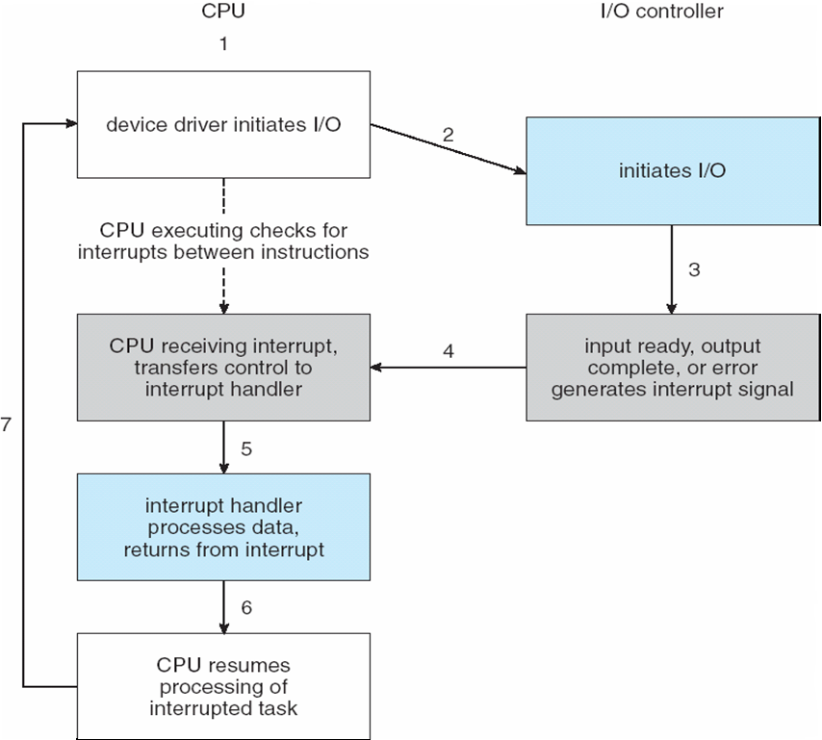
Interrupt-Driven I/O Cycle

Slide 15
Interrupts (Cont.)
3 kinds of interrupt
Exceptions/Faults: Errors: e.g., divide by zero
Hardware Interrupt: I/O!
Software-generated interrupt: System calls
Maskable and non-maskable
Maskable means turned-off
Usually exceptions/faults are not maskable.
Interrupt priority
Interrupt handling can be interrupted by higher priority interrupts.

Slide 16
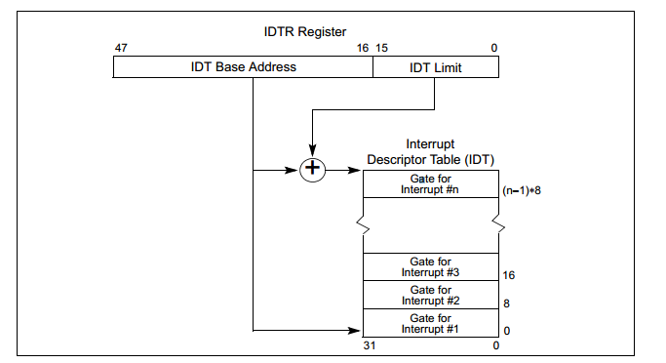
Interrupt Vector Table
Interrupt Vector
Unique for each interrupt
ISR
SW handling of interrupts
Interrupt Vector Table
Intel – IDT
Real addressing mode: IVT
Protected mode: IDT
Array of function pointers

Slide 17
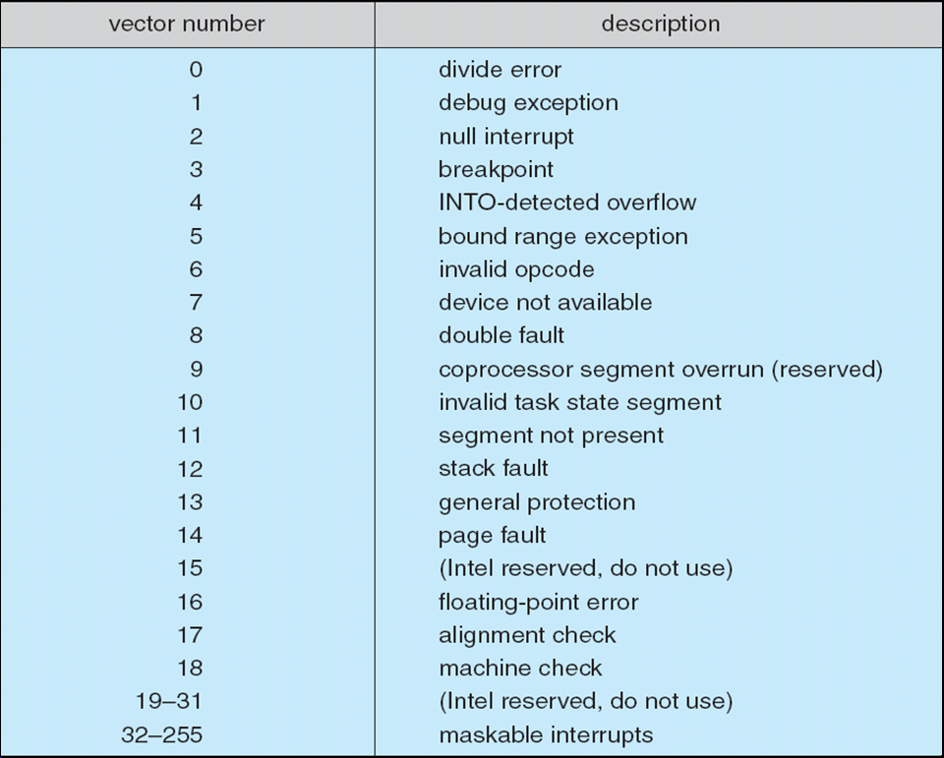
Intel Pentium Processor Event-Vector Table

Slide 18
Interrupts (Cont.)
Interrupt mechanism also used for exceptions
Terminate process, crash system due to hardware error
Page fault executes when memory access error
System call executes via trap to trigger kernel to execute request
Multi-CPU systems can process interrupts concurrently
If operating system designed to handle it
Used for time-sensitive processing, frequent, must be fast

Slide 19
How does CPU transfer control to ISR?
Memory
Must know the address of a function to call a function.
Where is the interrupt vector table located?
Memory
We want to know address containing the starting address of ISR for vector N
Base Address + 8 * N for 64 bit
Base Address + 4 * N for 32 bit
Question: how does the HW know where is the base?
Hardcoded (0x0000 to 0x03ff) during real mode
IDTR (Interrupt Descriptor Table Register) (Protected mode)
Who sets up the IDTR?
Who sets up the IDT?
.
.
.
0
0x…
ISR ADDRESS
1
0x…
2
0x…
.
.
.
N-1
0x…
N
0x…
.
.
.

Slide 20
DMA: Motivation Scenario
Copy 1KB from Disk 1 to Memory (Disk Read)
A simple way:
CPU req Disk1 controller for 1st byte
Disk1 prepares the byte. Put it in Data-IN register.
Interrupt CPU
ISR reads the byte in Data-IN
Status
Disk1 Controller
Data IN
Memory
Data OUT
Control
Status
Other Device Controller
Data IN
CPU
Data OUT
Control

Slide 21
DMA Scenario (Fig 13.5 Textbook)

Slide 22
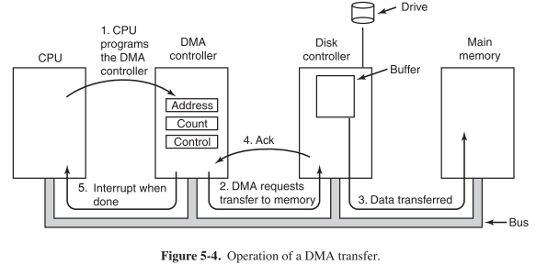
DMA Transfer Operation

Slide 23
Direct Memory Access - I
Allow devices to read/write memory directly without CPU intervention
Does not mean accessing the memory in the same cycle
Whether multiple devices (e.g. CPU) can access the memory at the same time depends on the memory design
Allows CPU processing to be in parallel with device to memory communication
Reduce number of interrupts

Slide 24
Direct Memory Access - II
Used to avoid programmed I/O (one byte at a time) for large data movement
Requires DMA controller
Bypasses CPU to transfer data directly between I/O device and memory
OS writes DMA command block into memory
Source and destination addresses
Read or write mode
Count of bytes
Writes location of command block to DMA controller
Bus mastering of DMA controller – grabs bus from CPU
Cycle stealing from CPU but still much more efficient
When done, interrupts to signal completion
Version that is aware of virtual addresses can be even more efficient – DVMA (allows a device to perform a transfer from two memory-mapped devices without the intervention of the CPU or the use of main memory as a staging ground)

Slide 25
Access HW device
User program access device directly?
User program talks with device driver via system calls open(), read(), write() etc
Protect data from access-control violations
Erroneous use leads to crash

Slide 26
How does this code execute?
int main()
{
int add;
int *add_p;
scanf(“%d”, &add);
add_p = (int*) add;
*add_p = 0;
}
libc functions : read() and write()
Context switch from user level
to kernel mode

Slide 27
MS-DOS and Intel 8088
Text/Code
Data
*add_p = 0;
OS
What happens?

Slide 28
CPU privilege modes
Instruction Set
Privileged Instructions
Kernel (Supervisor mode) and user mode
Privileged instructions
e.g. change the idtr value
Other instructions
e.g. add, sub etc
Set of instructions supported by the CPU
Other Instructions

